Slide 1
Optimising Breeder Blanket Design for Fusion Reactors
Semester 2 Masters Project Continuation
Vadan Khan
Rhodri Peters

Slide 2
Project Introduction and Overview
Key research area for contemporary Fusion Projects
Our Approach: Neutron transport simulations
Semester 1 continuation
Previously focused on material selection
Semester 2 focus: Optimising a Heterogeneous Design
Fixed material choices to optimum from last semester
Novel Methodology: Algorithm to explore large parameter spaces faster
Bayesian Optimisation

Slide 3
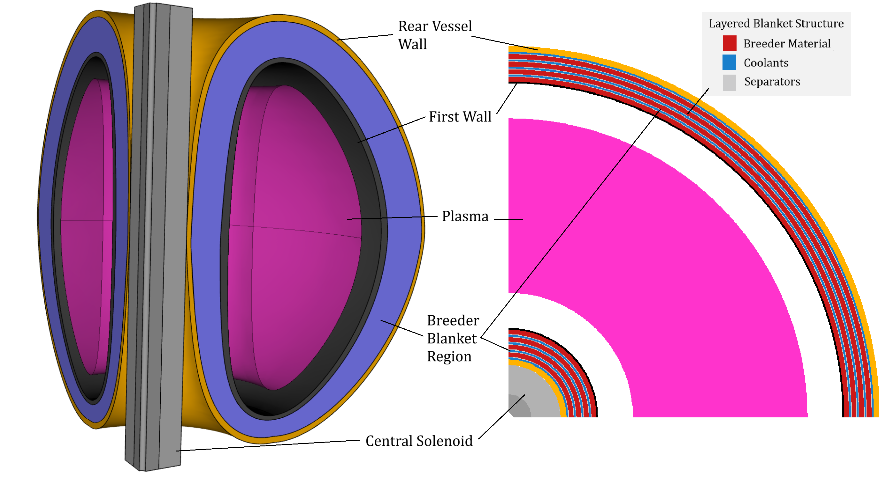
Blanket Design
Heterogeneous (layered) blanket
4 Alternating breeder and coolant layers
Breeder: Eutectic Li₁₇Pb₉₃
Coolant: H₂0
Separators: Eurofer97 Steel
First Wall: Zircalloy

Slide 4
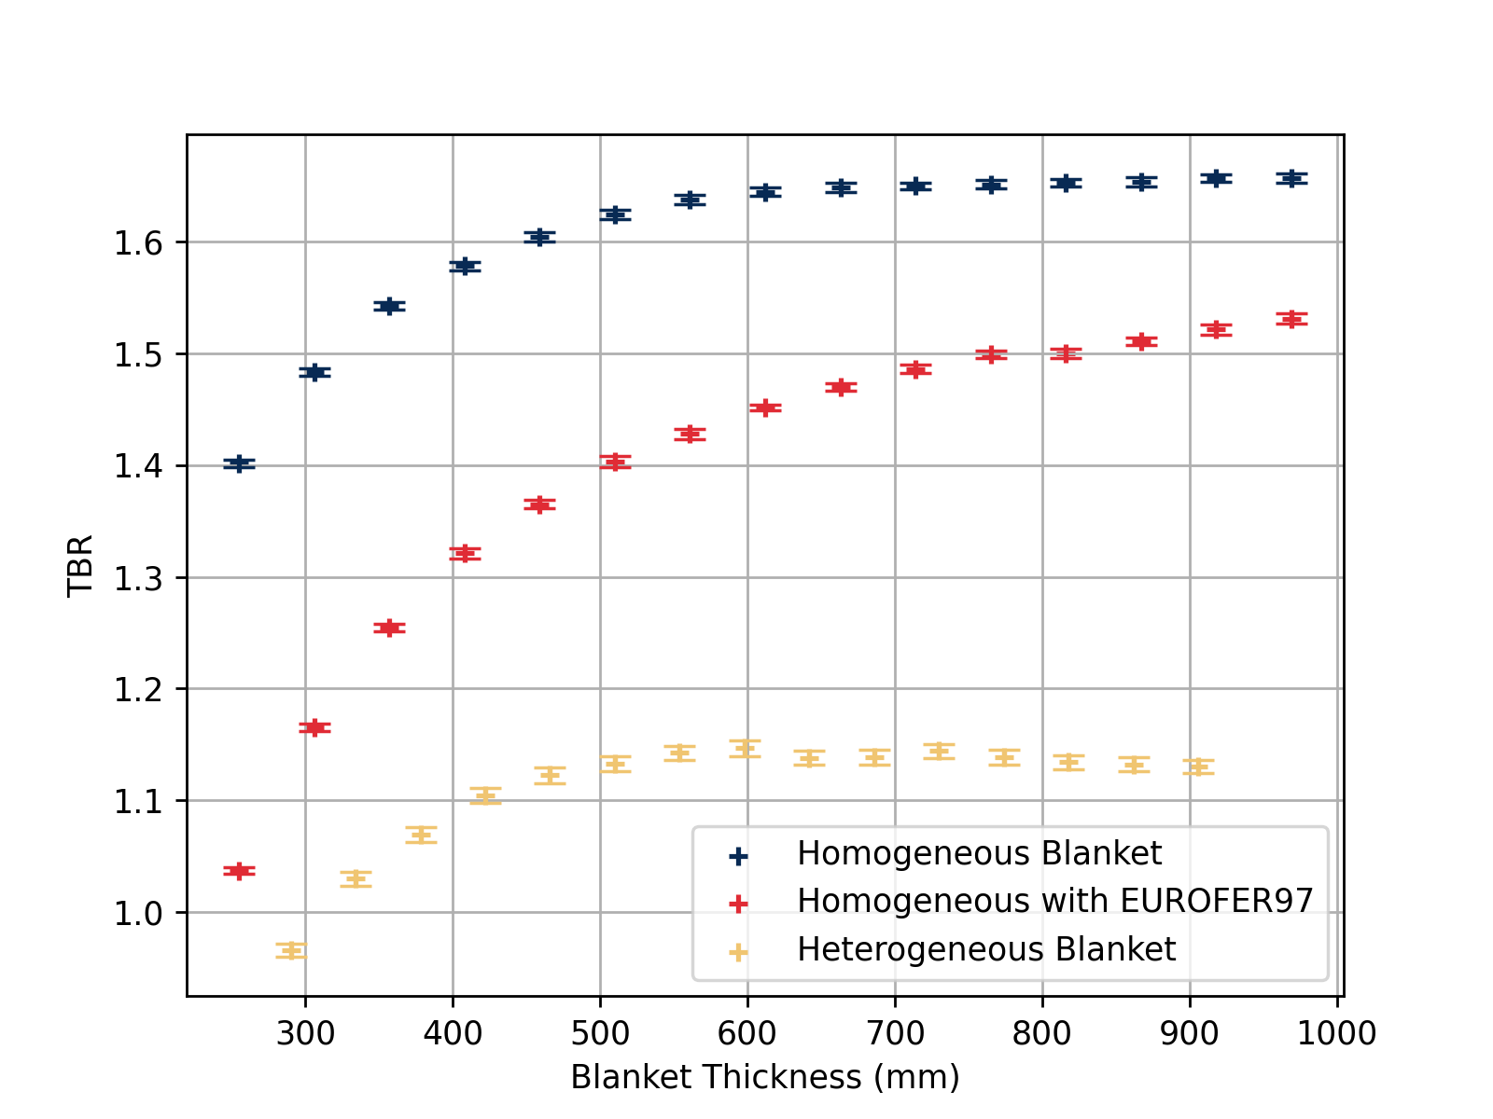
Heterogeneous Effects
Compare heterogeneous breeder to homogeneous designs
Separator material added in homogenous and heterogeneous designs
Heterogeneous blankets have significantly lower TBR

Slide 5
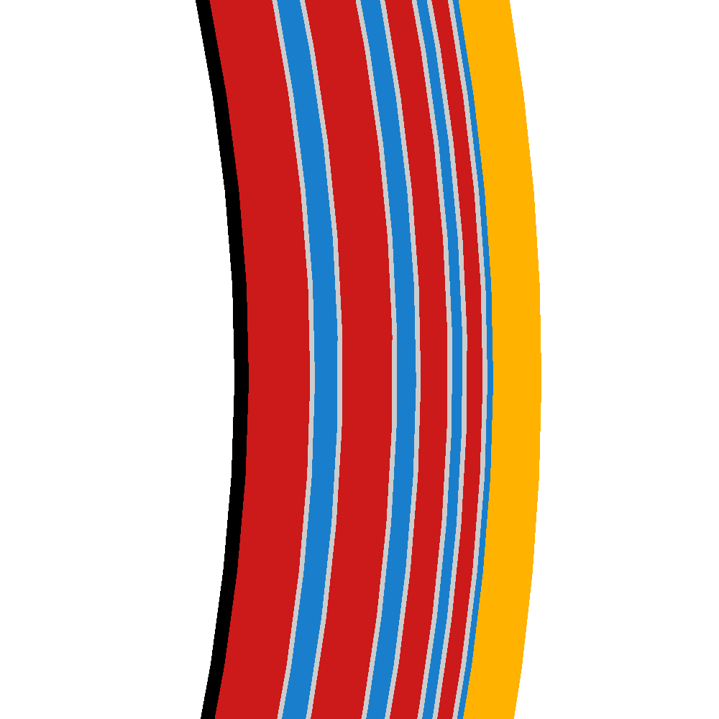

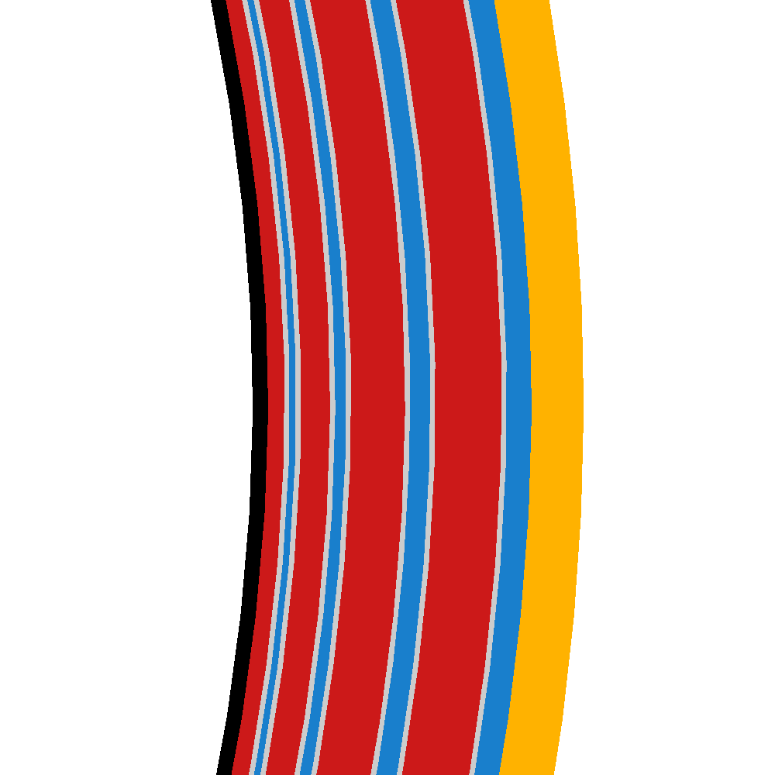



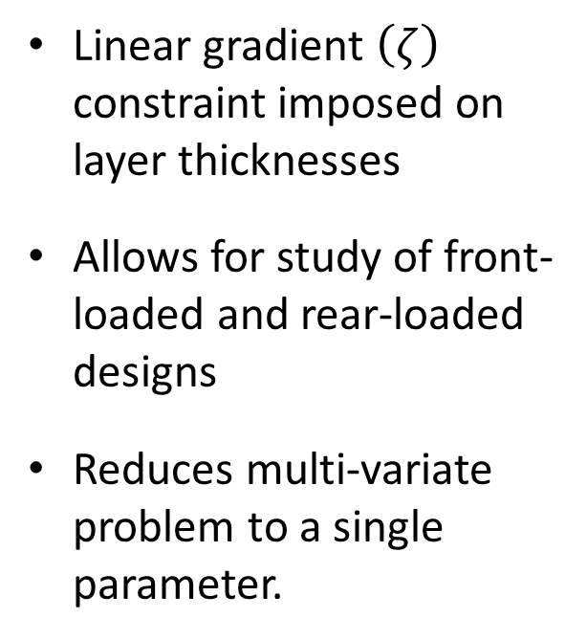
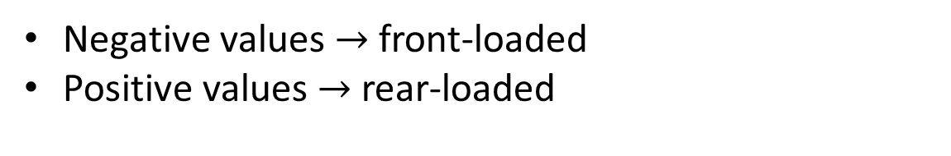
Linear Gradient Thickness Constraint
Linear gradient $\left(ζ\right)$ constraint imposed on layer thicknesses
Allows for study of front-loaded and rear-loaded designs
Reduces multi-variate problem to a single parameter.
$$ζ=−0.3$$
$$ζ=0$$
$$ζ=0.3$$
Negative values $→$ front-loaded
Positive values $→$ rear-loaded

Slide 6
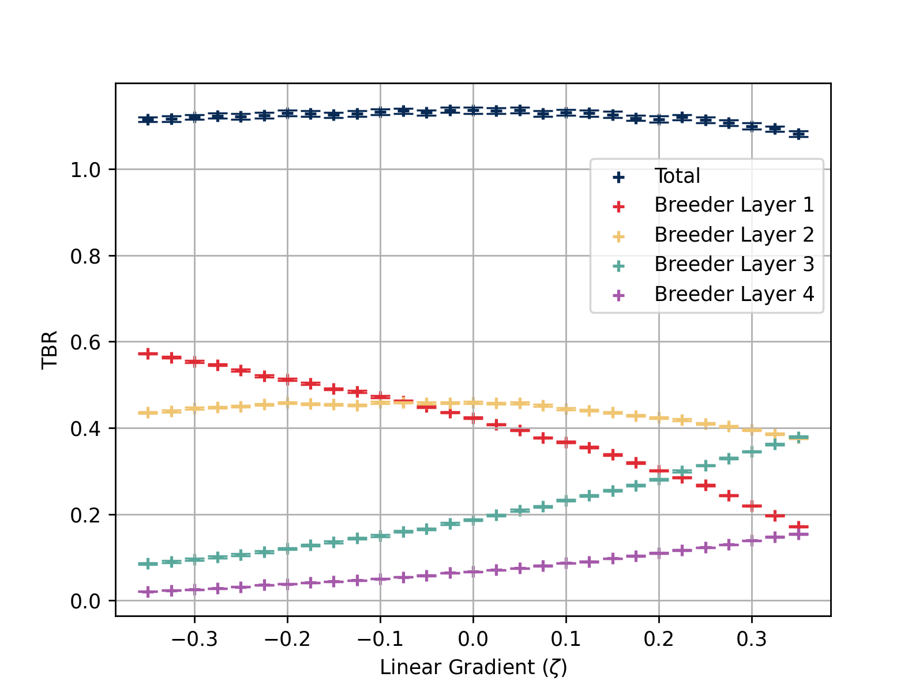
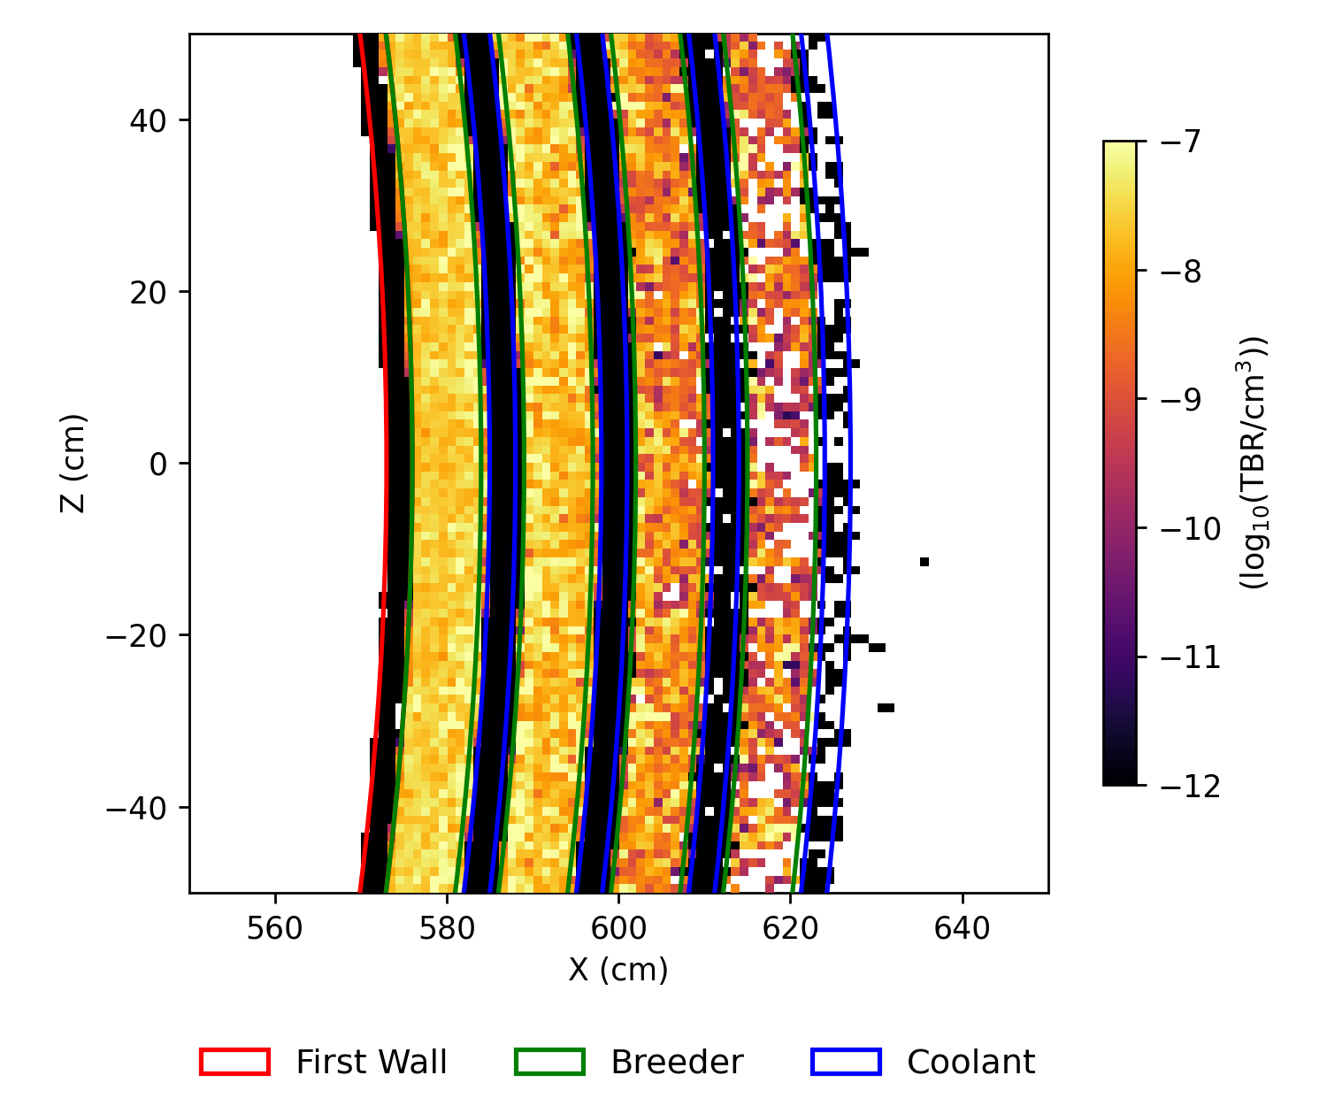
TBR: Tritium Breeding Ratio
Total TBR ~constant
Breeding shifted to back layers if thickness backloaded

Slide 7
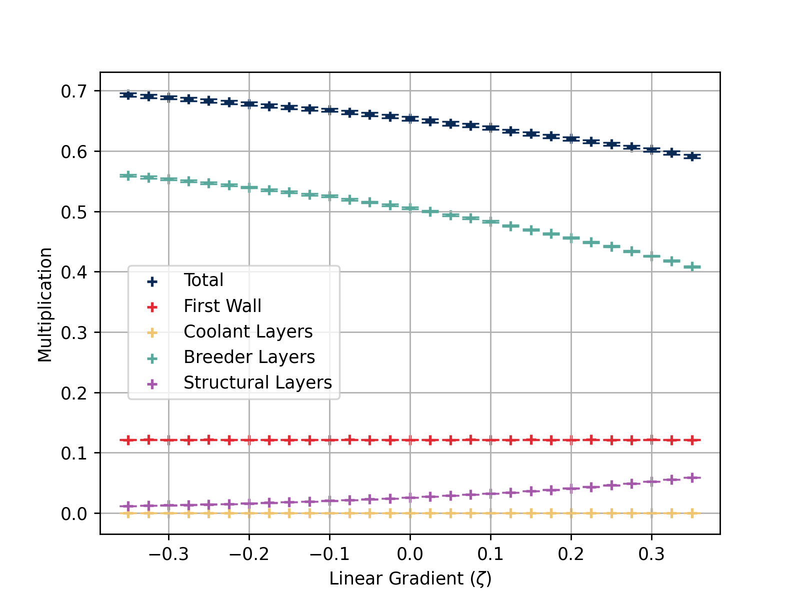
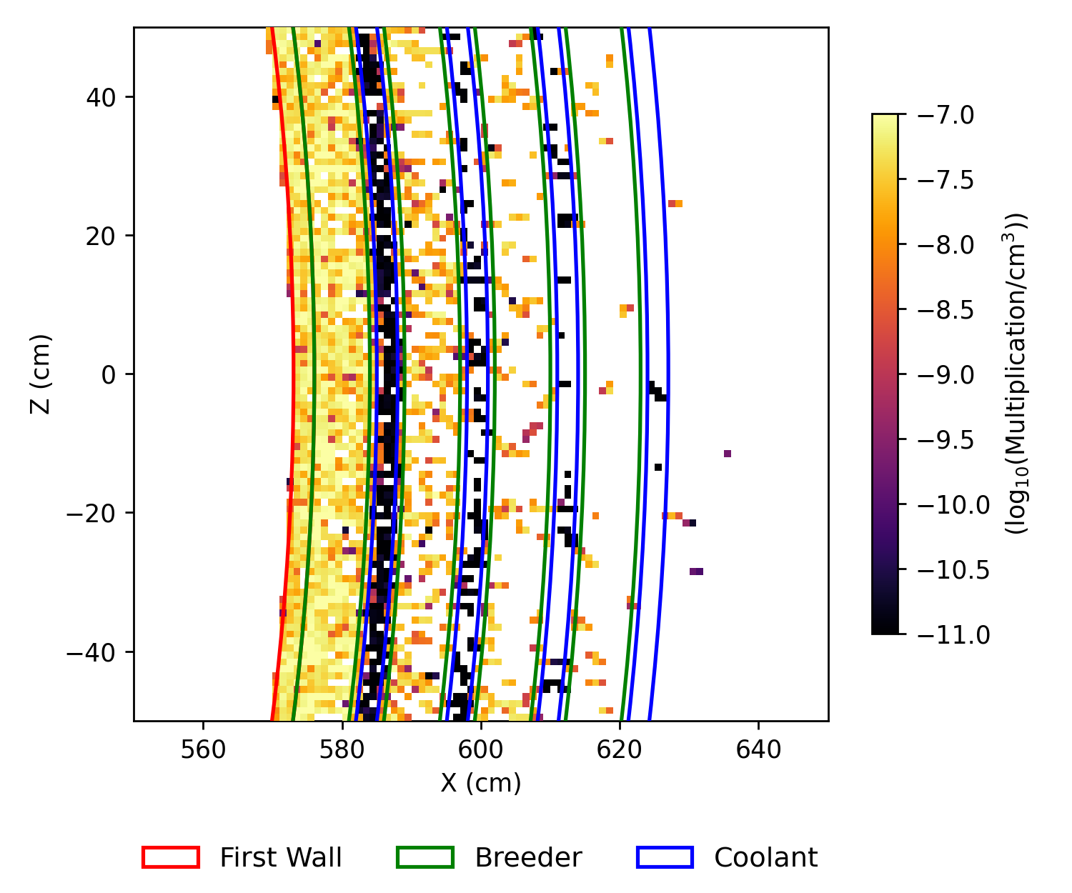
Multiplication
Multiplication decreases for backloaded configurations

Slide 8
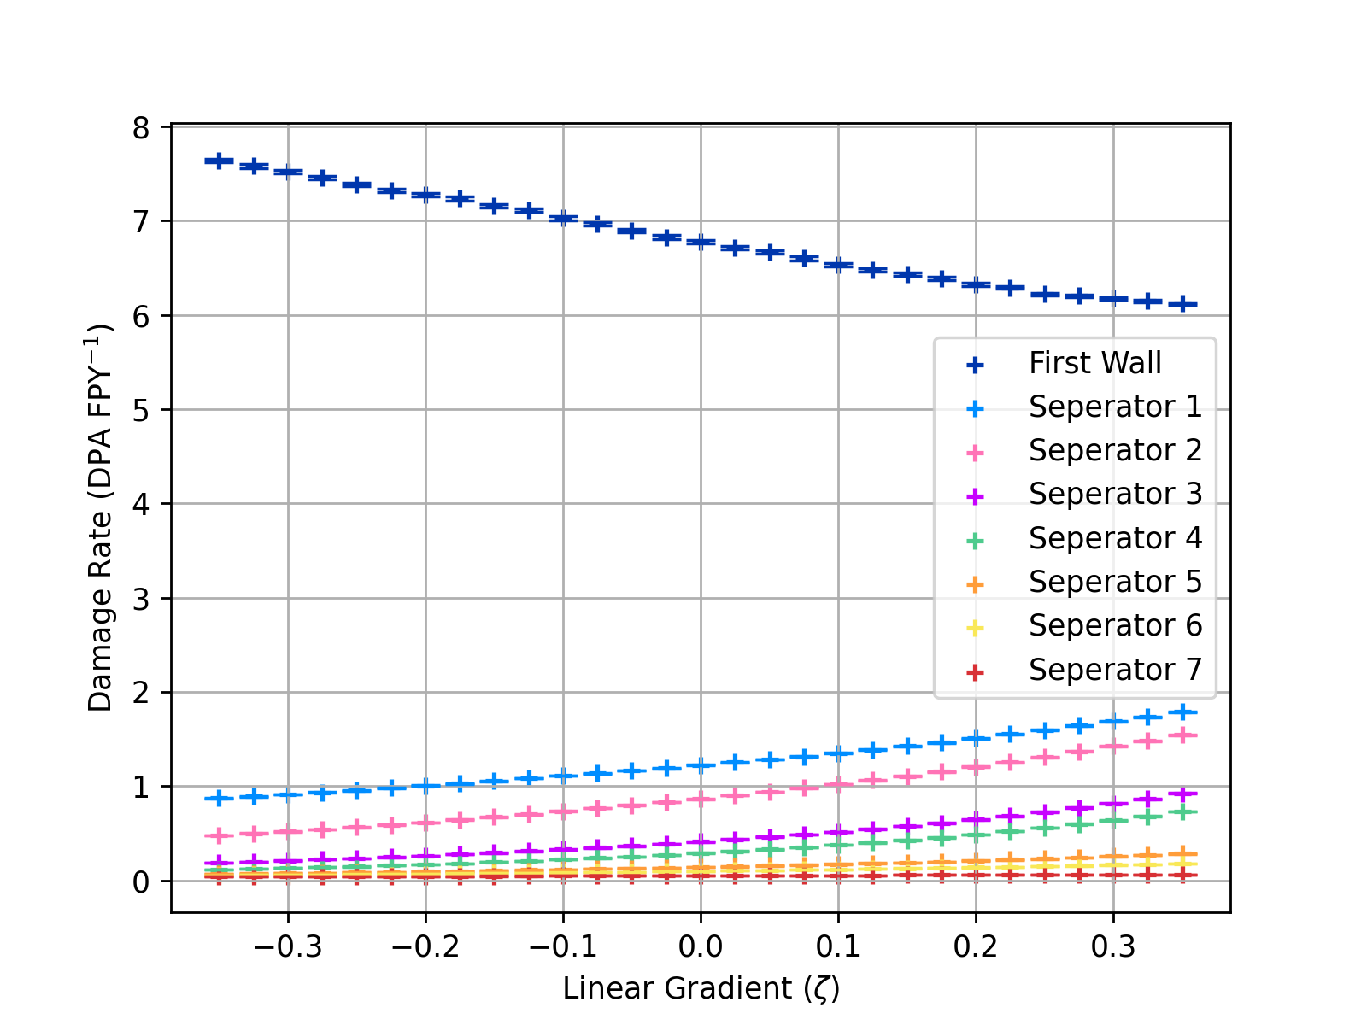
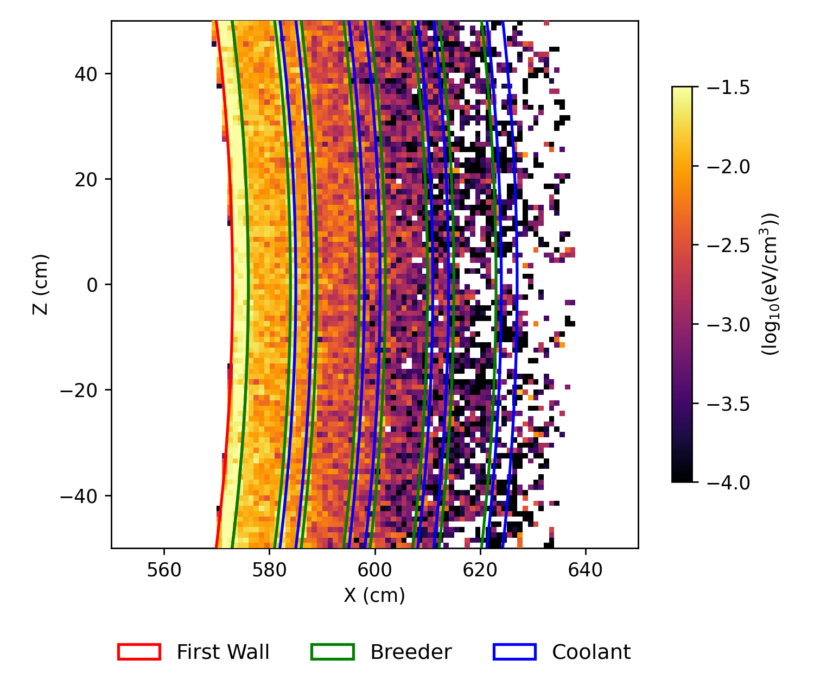
Damage
Backloaded configurations suffer from greater separator damage
Frontloaded configurations suffer from greater front wall damage

Slide 9
ML Theory: SOBO-GPR Iteration Loop
An ML (Bayesian Optimisation) method to run the minimal number of simulations for a maximum understanding of a parameter space
Simulated Test Data Pool
Add new test result to pool.
Improves future surrogate model approximations
GPR Surrogate Model
Approximated Optimum (at this iteration)
Optimal Regions & Uncertainty
SO Acquisition Function
Best region to explore
SO: Single-Objective
BO: Bayesian Optimisation
GPR: Gaussian Process Regression
Selected New Simulation

Slide 10
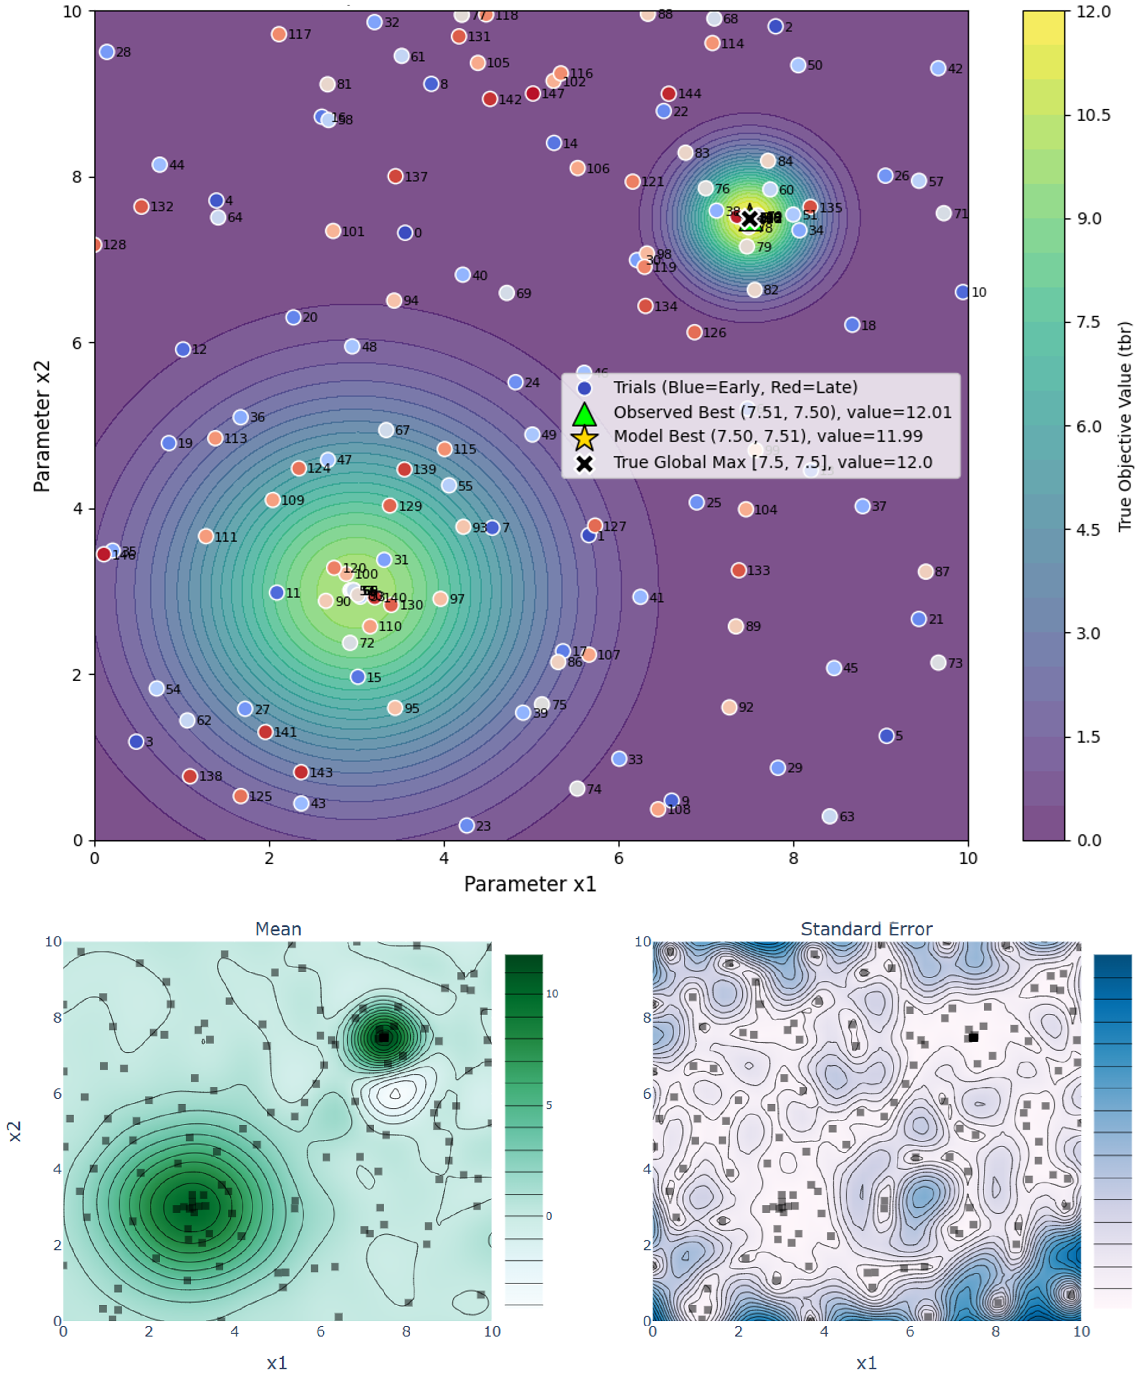
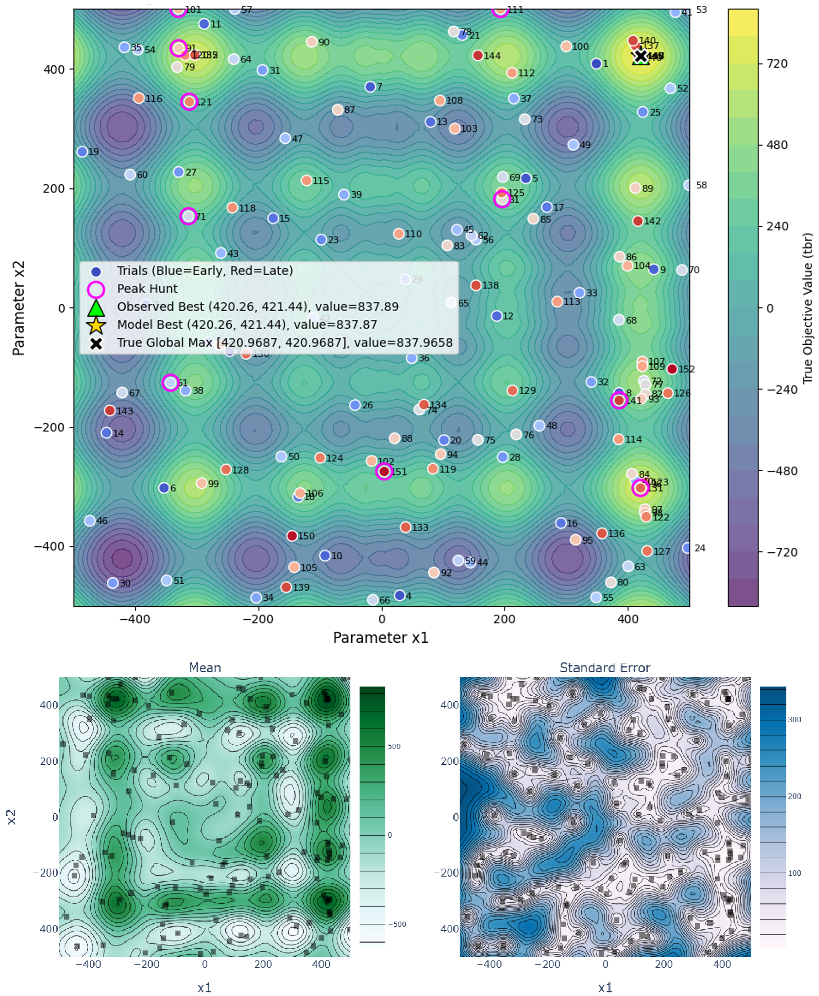
ML Testing Examples
Plots of the “true” function to find the maximum of
+
Points the Algorithm chose to sample
Final Iteration Surrogate Model + Uncertainty

Slide 11
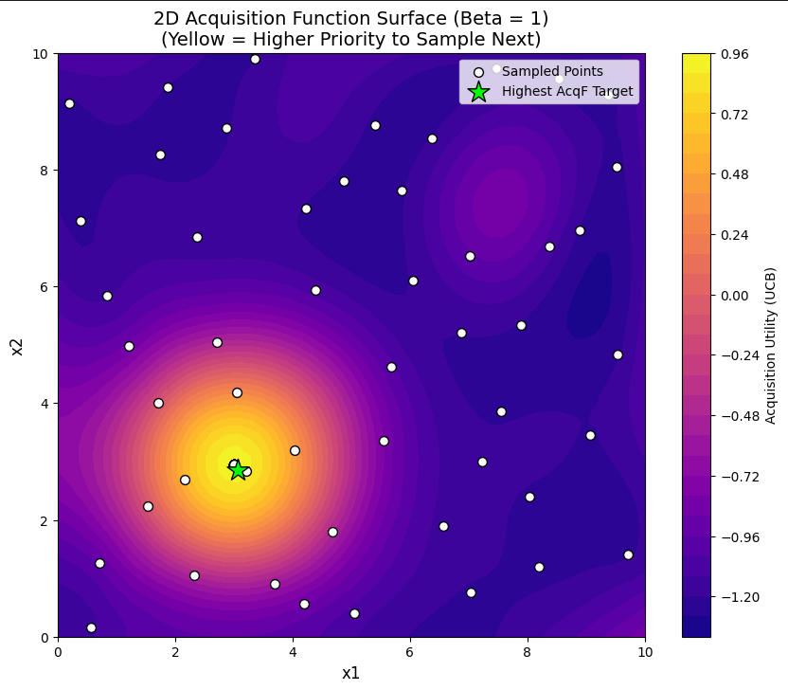
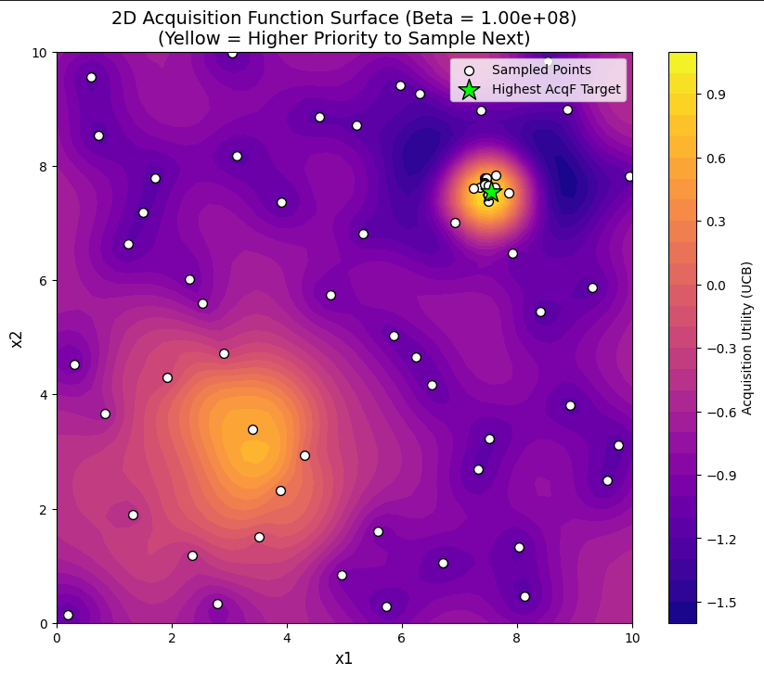
Acquisition Function Tuning
“Greedy” tuning:
Search for peaks in regions that we have historically performed well
Explorative tuning:
Explore the wider parameter space to hunt for “hidden” peaks

Slide 12
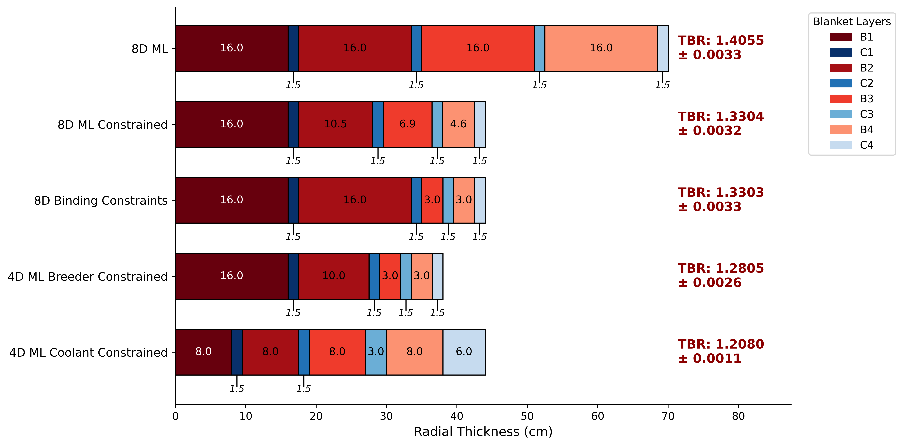
Optimal Configurations from BO studies
The optimiser consistently attempted to maximise breeder thickness (front first) and minimise coolant thickness (front first).

Slide 13
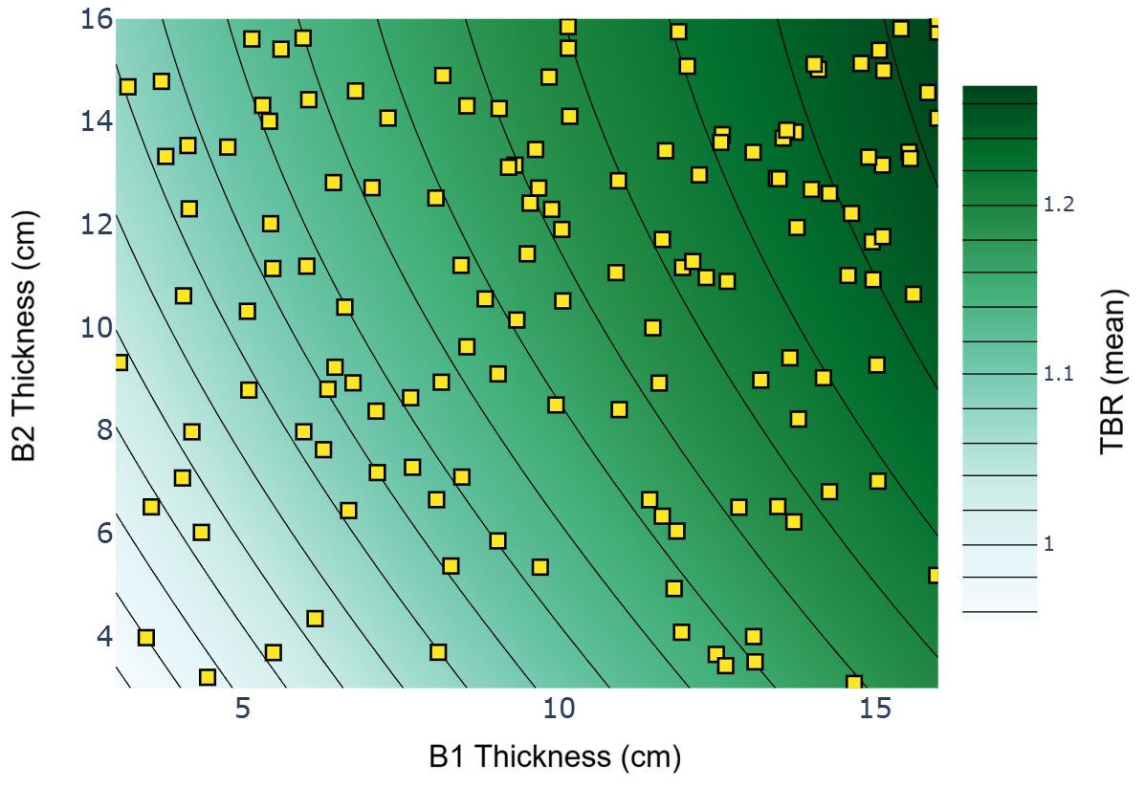
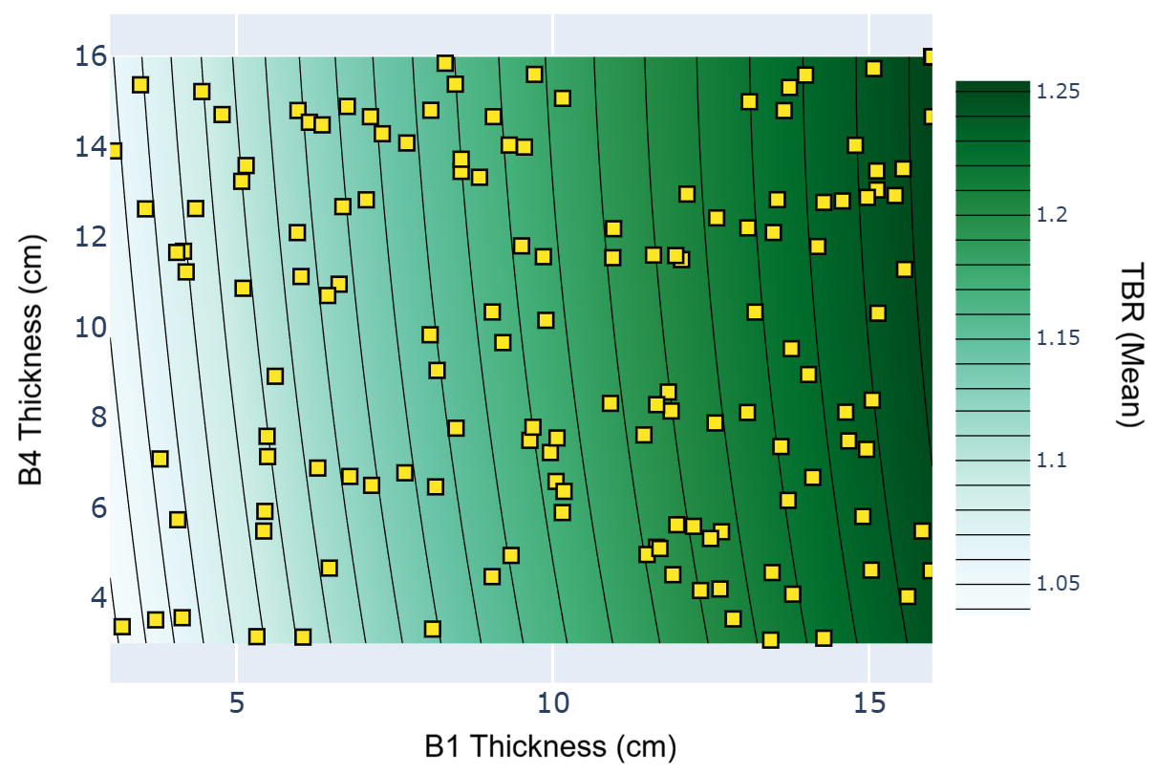
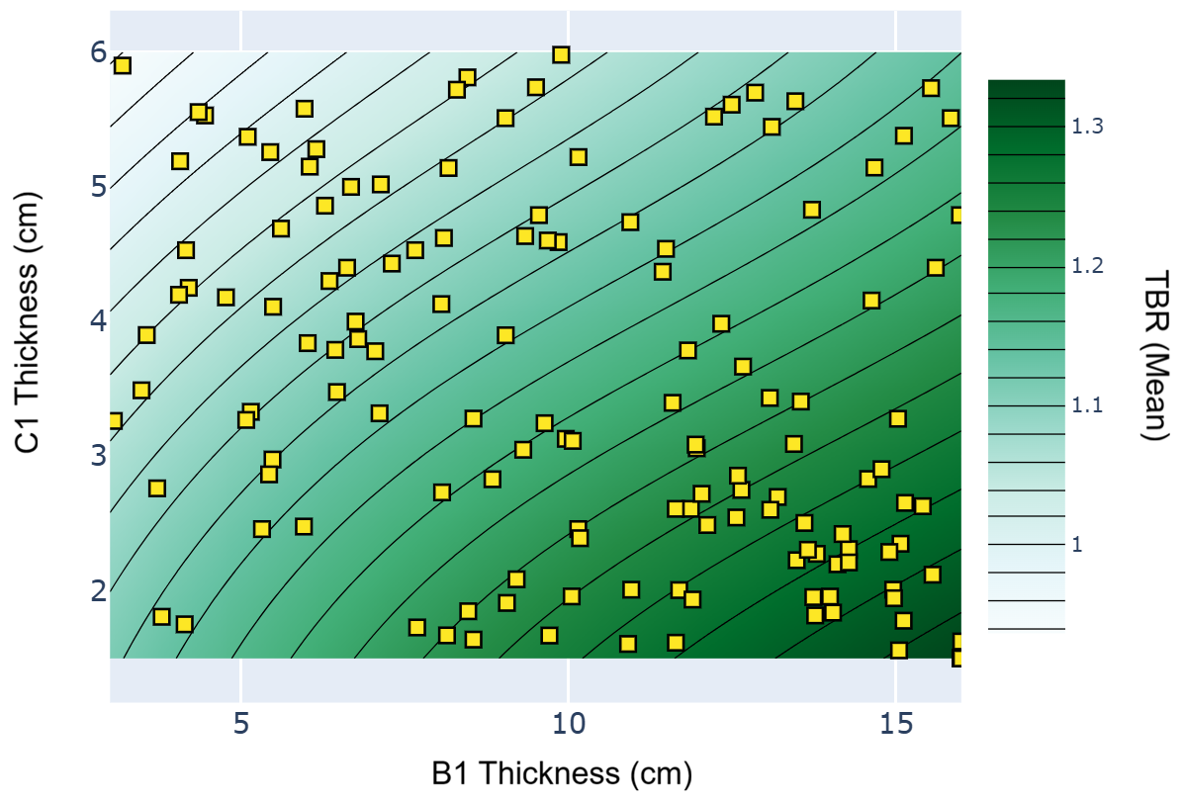
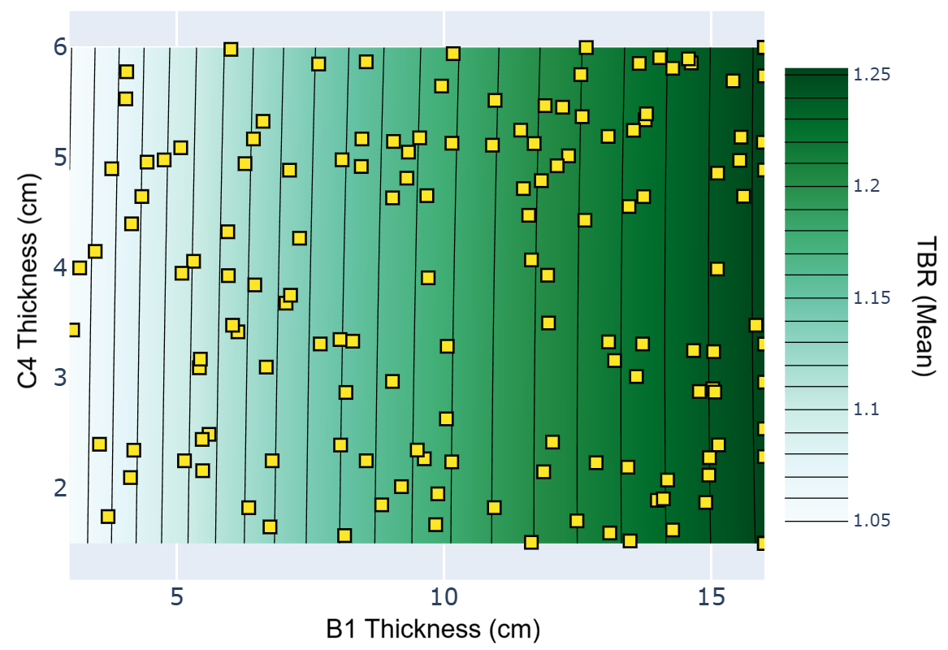
ML Parameter Sensitivity
2D parameter sensitivity plots
Offers deeper physical understanding
Compared B1 TBR contribution to other layers
Front layers are more impactful than rear layers
Demonstrates a clear “corner solution”.

Slide 14
Conclusions → Next Steps
Optimal Design for TBR maximisation Clear:
Maximise breeder and minimise coolants
Broaden study to investigate other materials
Optimal results could be vary
Necessitates Holistic Study to balance other Parameters
Heat extraction
Material Damage
Thickness / cost
SOBO-GPR Algorithm could support this research
Modular to different materials & simulation functions
Multi-Objective Optimisation could be implemented to balance other parameters

Slide 15
BACKUP SLIDES

Slide 16
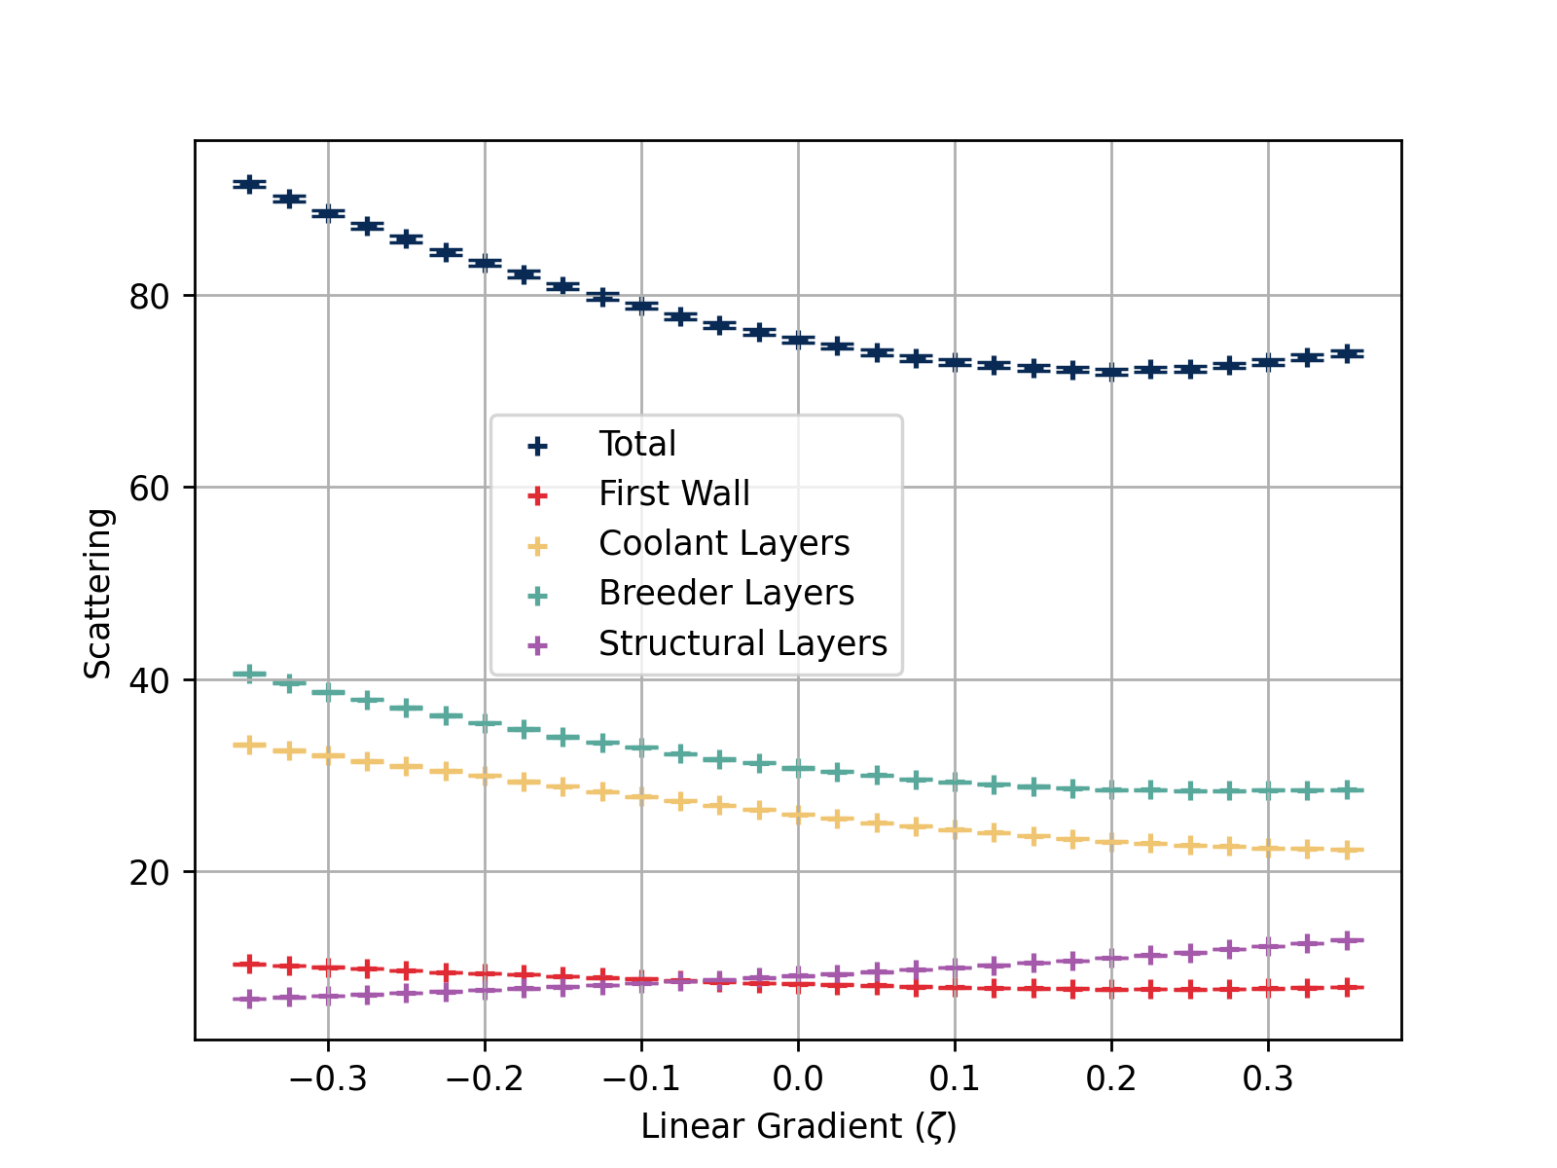
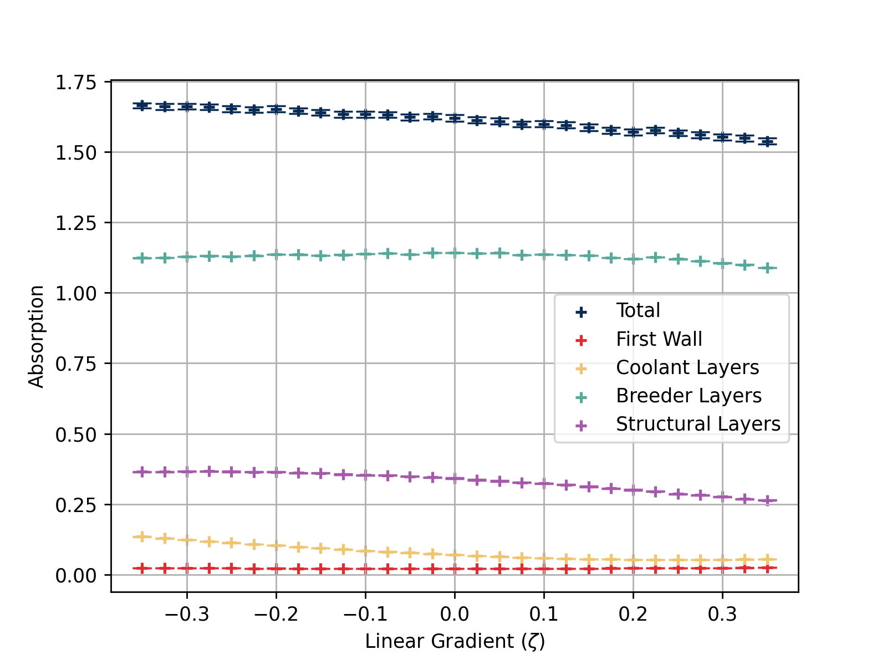
Scattering vs Absorption Zeta Sweeps
Backloaded: Higher scattering but lower Absorption

Slide 17
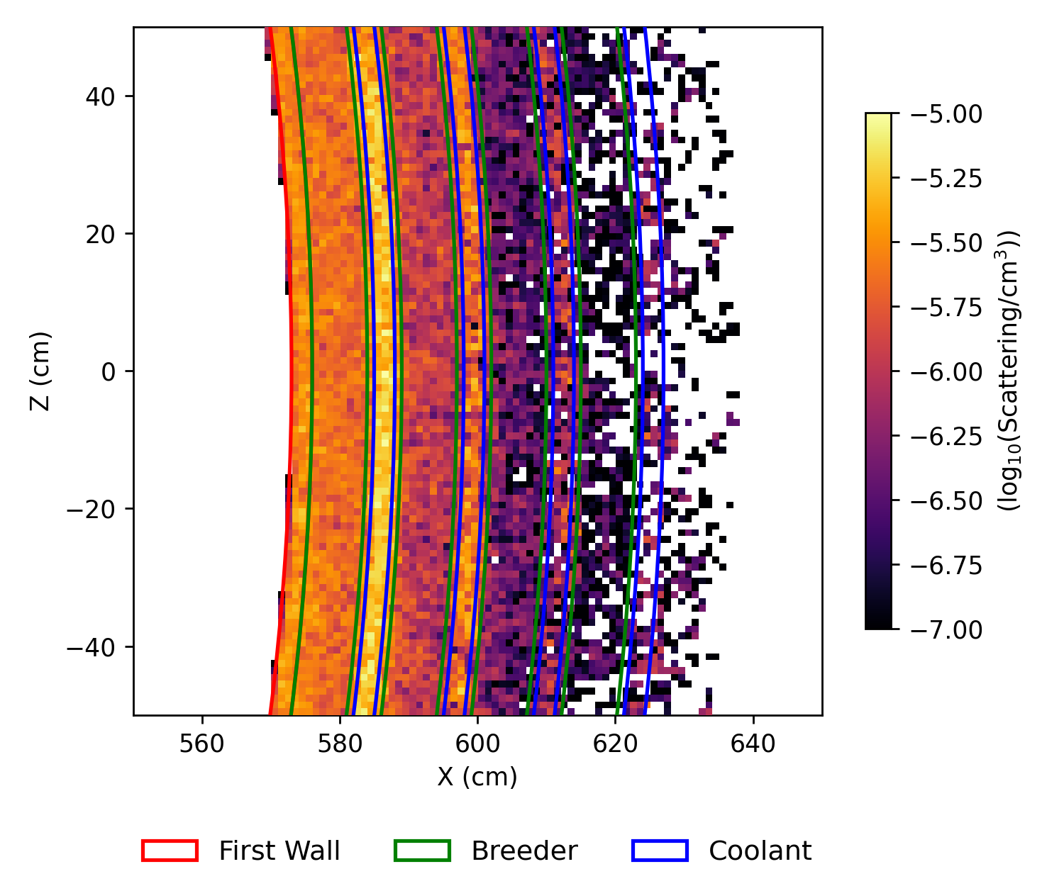
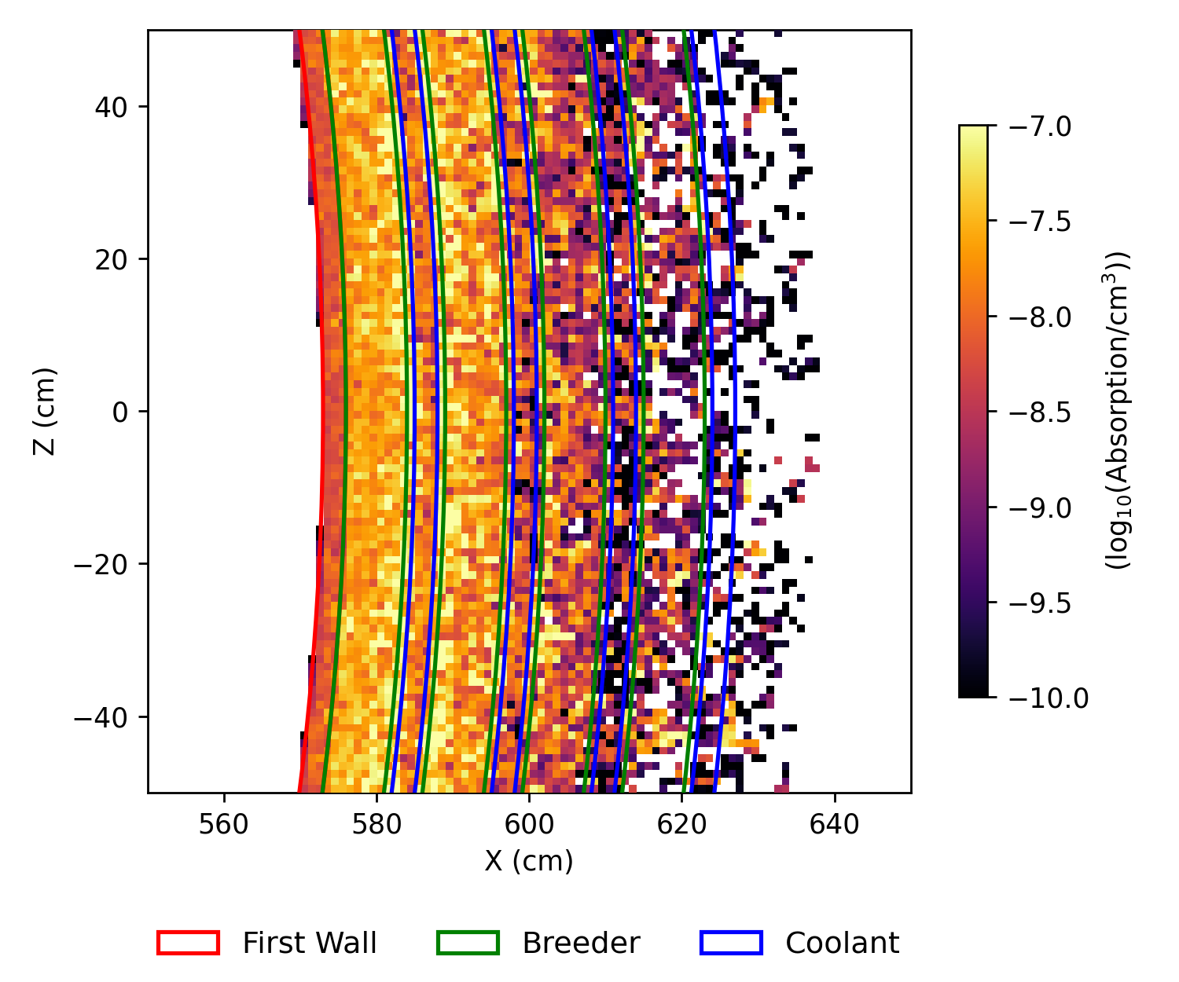
Scattering & Absorption Heat Maps
Also have bright peaks in separators

Slide 18
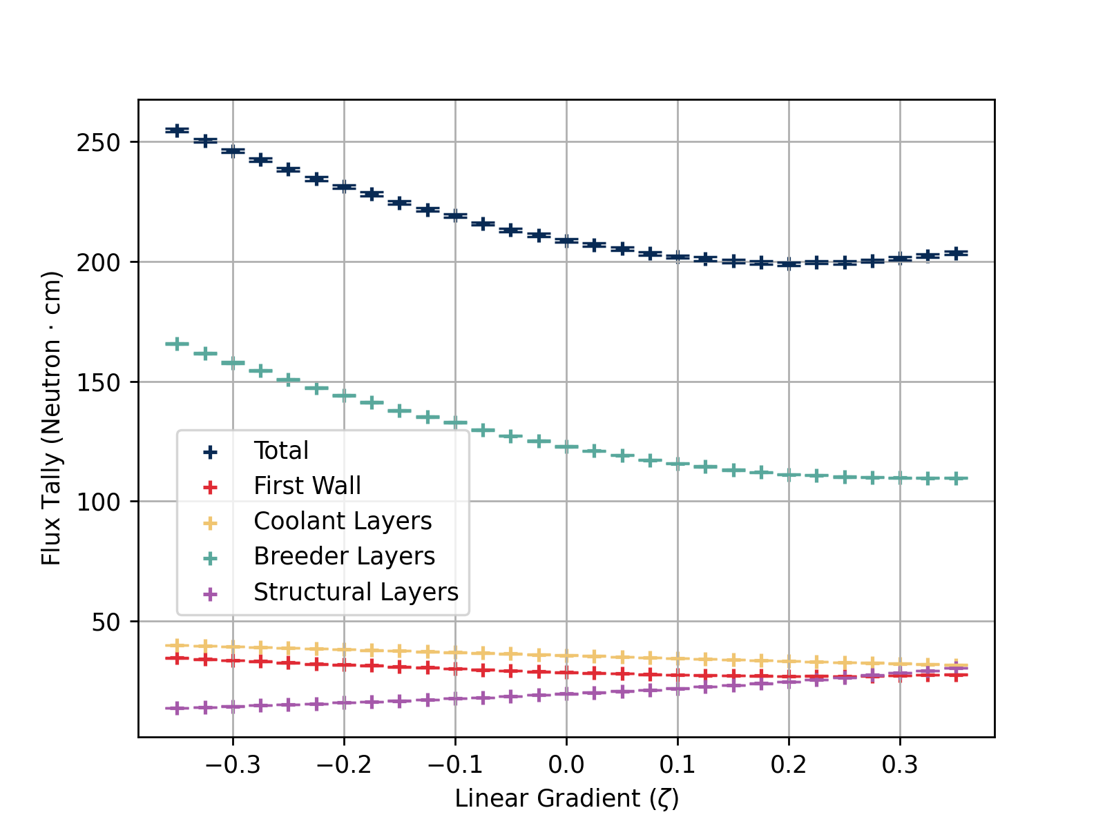
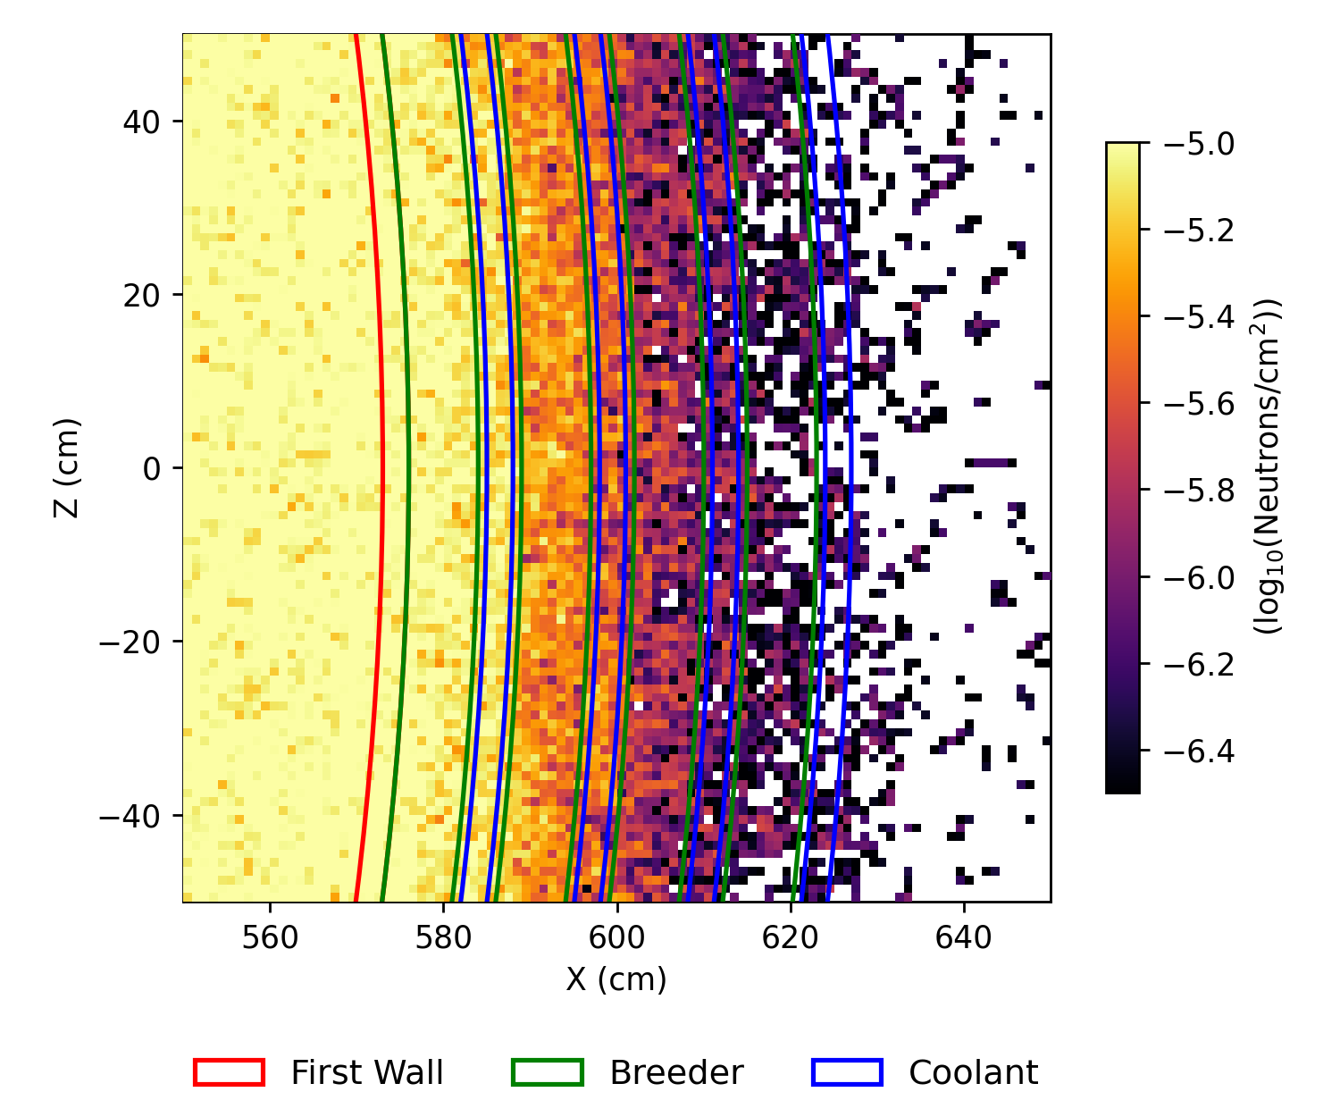
Total Neutron Flux

Slide 19
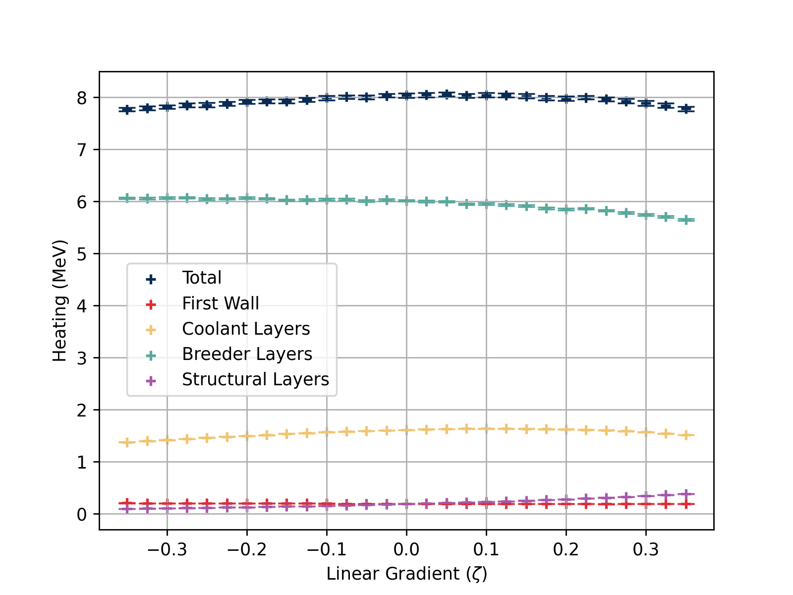
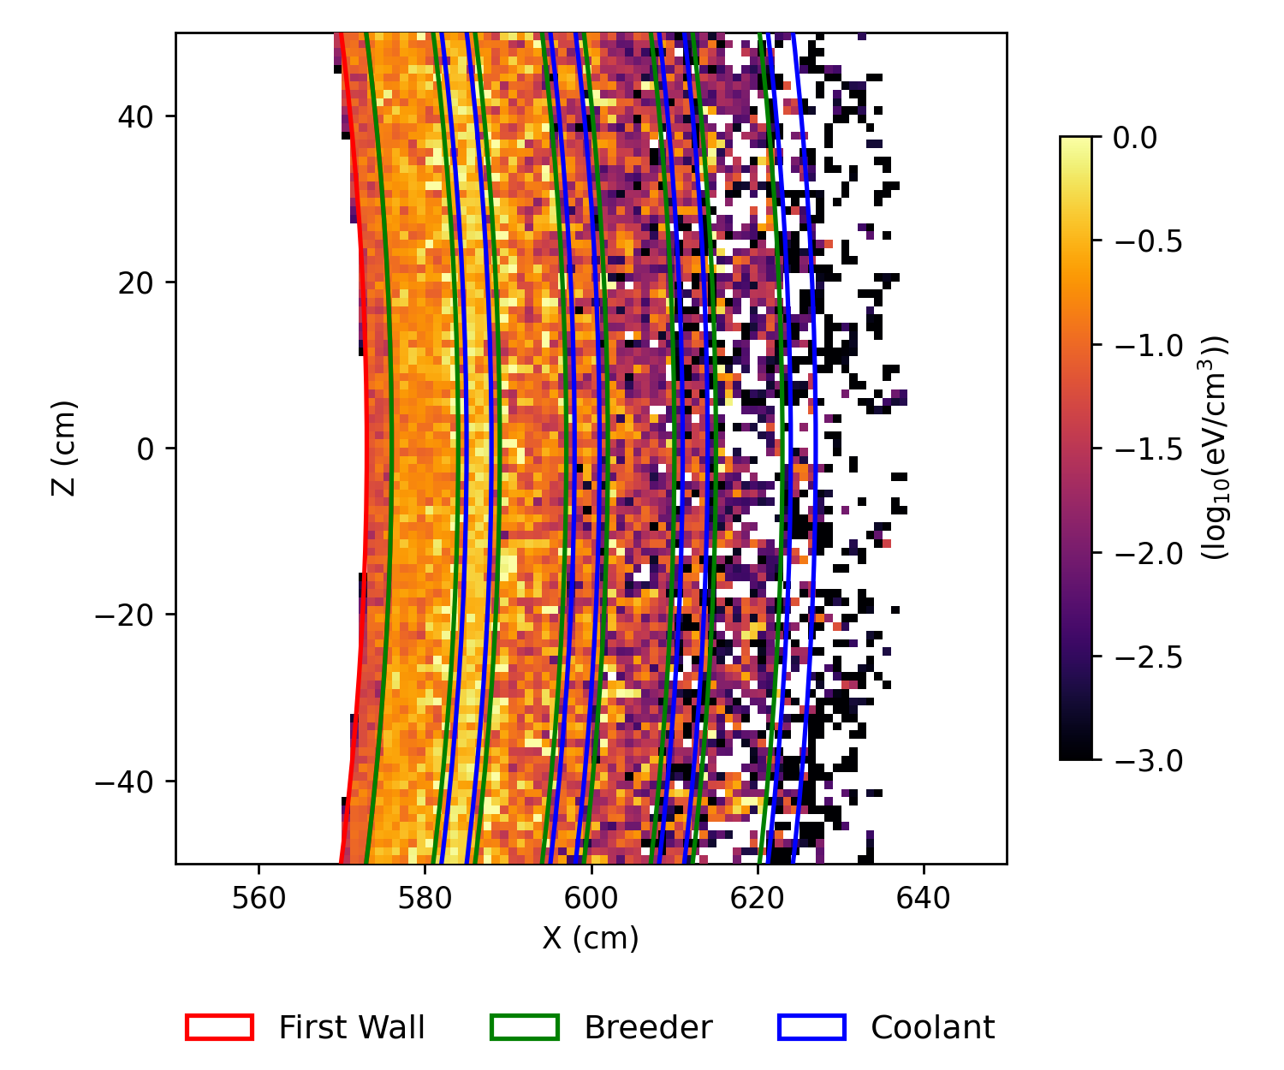
Heating per Source Neutron

Slide 20
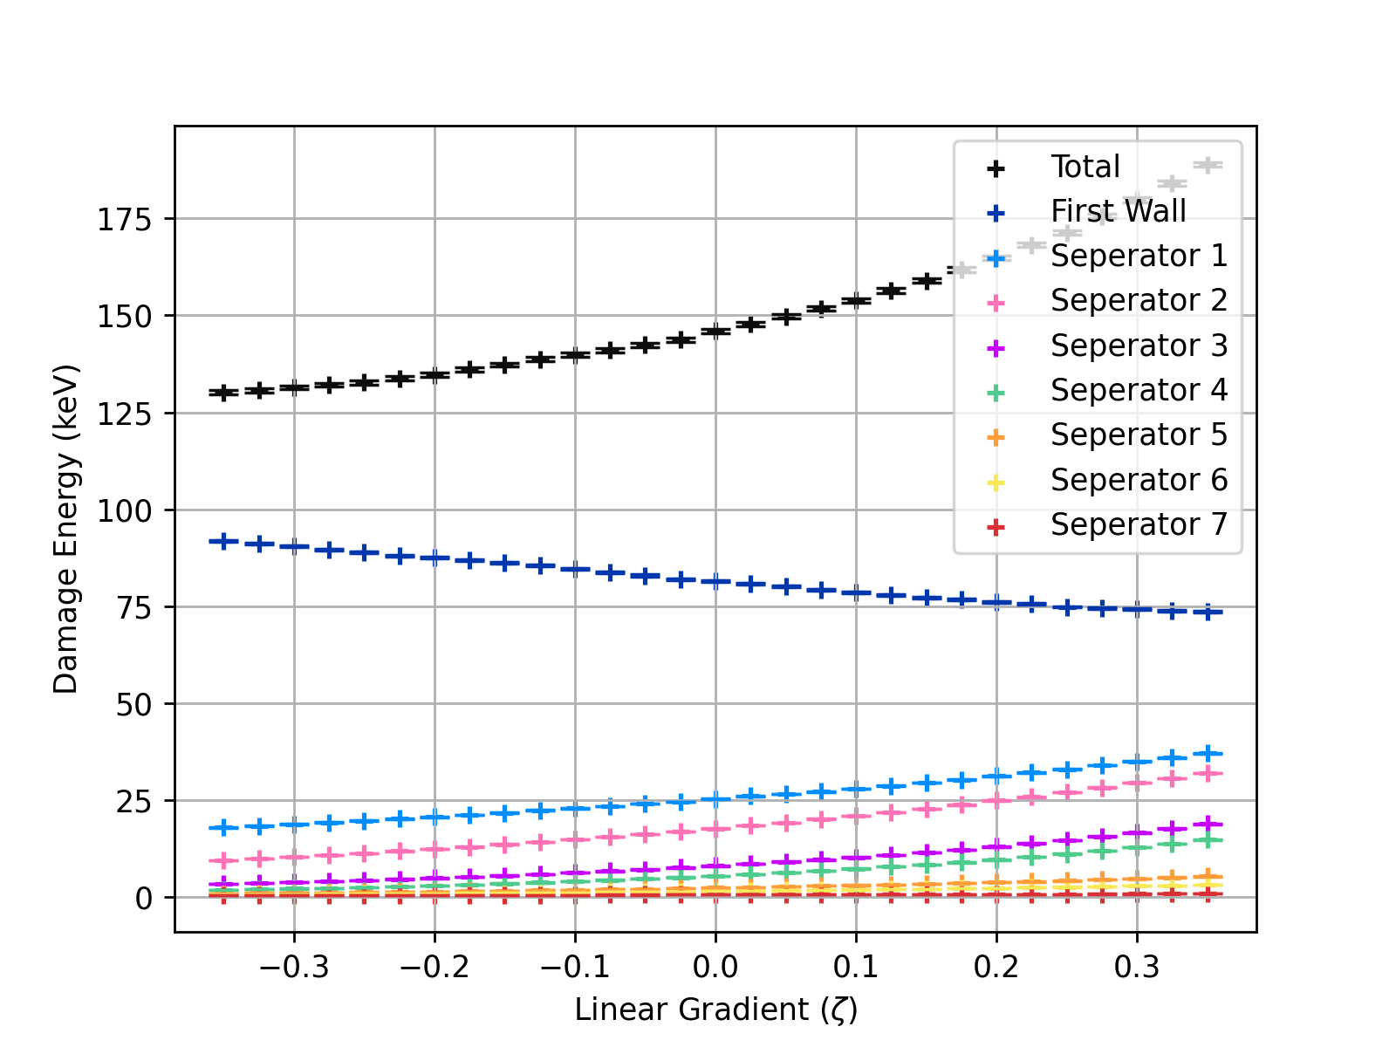
Damage Energy Zeta Sweep

Slide 21
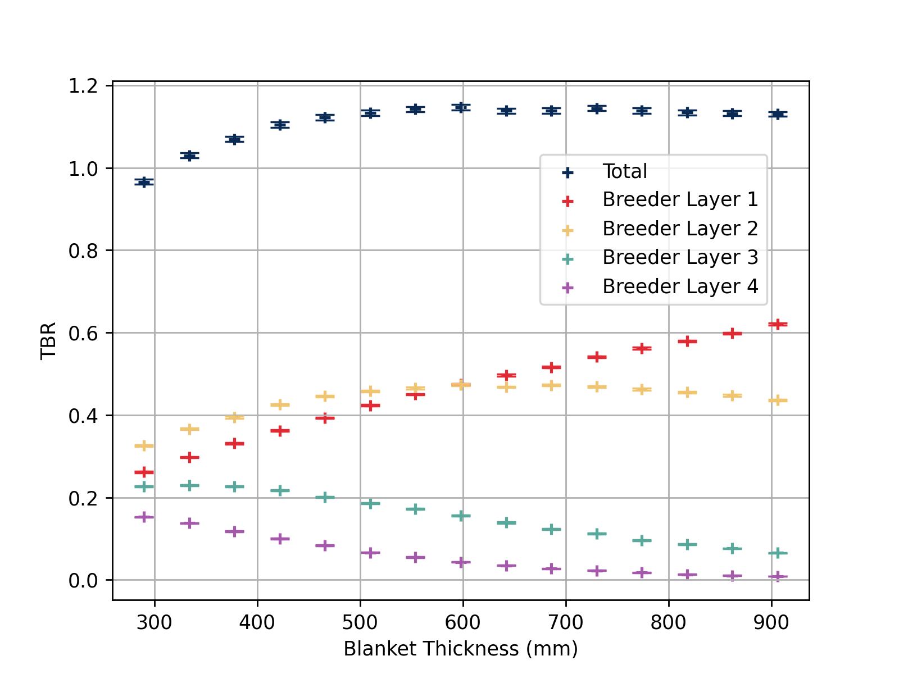
Layer-wise Heterogeneous TBR vs. Thickness

